Slide 1
Machine Learning Predictive Failure Times Data
Eric Schnelker, Naveena Yeppala

Slide 2
Outline
Introduction
RNN
RNN Results
LSTM (single-step and multi step)
LSTM Results
Conclusion

Slide 3
Introduction
Long-Short term memory in terms of single step and multi step is used for prediction
Recurrent neural network is used to compare the LSTM
Type of data used – failure times data
Dataset – SYS1
Data is dependent on time

Slide 4
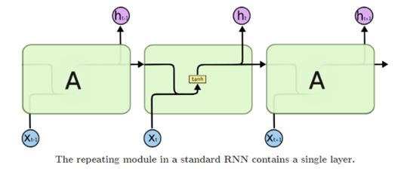
Recurrent Neural Network
The RNN is a network that allows previous outputs to be used as inputs while having hidden states and it is mostly used in natural language processing

Slide 5
Recurrent Neural Network (advantages and disadvantages)
Advantages :
Process the input of any length
Weights are shared across time
Disadvantages:
Computation time slow
Bad accuracy
Can not access information from long time ago

Slide 6
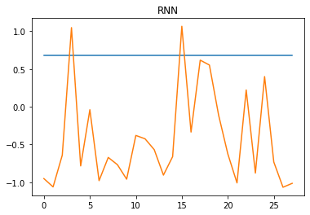
Recurrent Neural Network Results
Not satisfactory given the drawbacks
Mean squared error value is very high

Slide 7
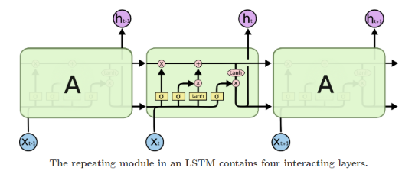
Long-Short Term Memory
Is a special kind of RNN
Long term dependency data
Single-step and multi-step prediction is possible
Univariate and multivariate type of data both can e considered

Slide 8
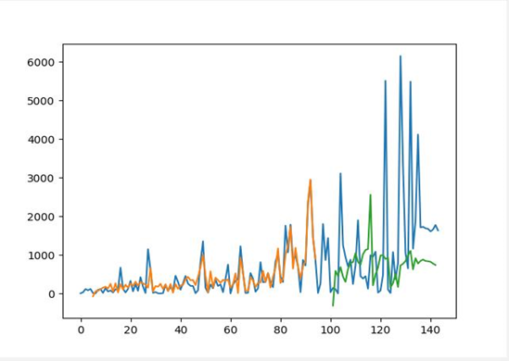
blue is initial data, orange is training, green is test

Slide 9
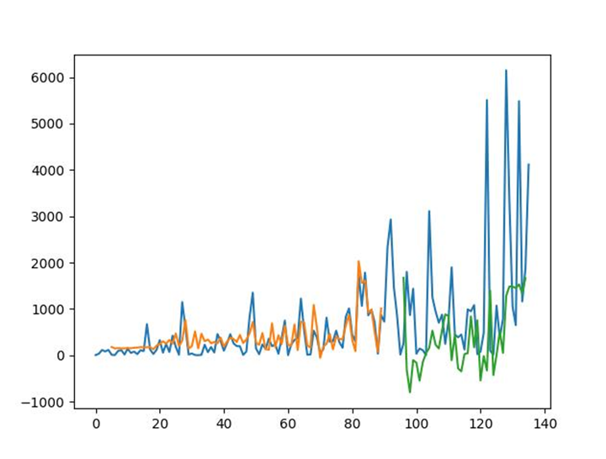
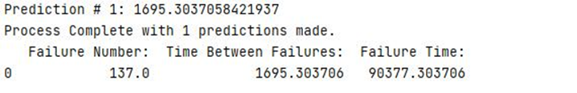
LSTM Results single step

Slide 10
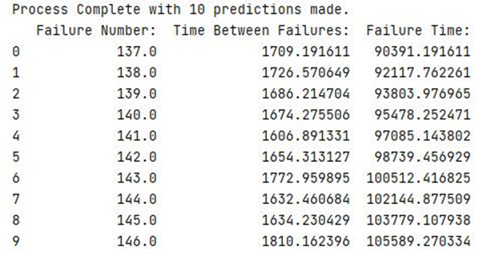
LSTM Results Multi-Step

Slide 11
Conclusion
The failure time data works well with LSTM it reliable and has better accuracy than RNN, the greater number of data points and features fed to the model the accuracy increase and makes it reliable and accurate.
The single step and multi-step predictions make it a lot easier to get the required number of future points.
Further moving window method can also be considered for the predictions.

Slide 12
Acknowledgment
[1]https://www.facebook.com/MachineLearningMastery, “Time Series Prediction with LSTM Recurrent Neural Networks in Python with Keras,” Machine Learning Mastery, Jul. 20, 2016. https://machinelearningmastery.com/time-series-prediction-lstm-recurrent-neural-networks-python-keras/ (accessed Apr. 28, 2021).
‌
[2]Lianne, “3 Steps to Forecast Time Series: LSTM with TensorFlow Keras | Towards Data Science,” Medium, Mar. 22, 2020. https://towardsdatascience.com/3-steps-to-forecast-time-series-lstm-with-tensorflow-keras-ba88c6f05237 (accessed Apr. 28, 2021).
‌[3] J. Chung, C. Gulcehre, and K. Cho, “Empirical Evaluation of Gated Recurrent Neural Networks on Sequence Modeling,” 2014. [Online]. Available: https://arxiv.org/pdf/1412.3555.pdf.
‌ [4] M. Phi, “Illustrated Guide to LSTM’s and GRU’s: A step by step explanation,” Medium, Sep. 24, 2018. https://towardsdatascience.com/illustrated-guide-to-lstms-and-gru-s-a-step-by-step-explanation-44e9eb85bf21.
[5] https://www.facebook.com/pranjal.srivastava3, “Long Short Term Memory | Architecture Of LSTM,” Analytics Vidhya, Dec. 10, 2017. https://www.analyticsvidhya.com/blog/2017/12/fundamentals-of-deep-learning-introduction-to-lstm/.
[6]Wikipedia Contributors, “Long short-term memory,” Wikipedia, Mar. 25, 2021. https://en.wikipedia.org/wiki/Long_short-term_memory#:~:text=Long%20short%2Dterm%20memory%20(LSTM)%20is%20an%20artificial%20recurrent,the%20field%20of%20deep%20learning.&text=LSTM%20networks%20are%20well%2Dsuited,events%20in%20a%20time%20series.
‌
[7]“CS 230 - Recurrent Neural Networks Cheatsheet,” Stanford.edu, 2021. https://stanford.edu/~shervine/teaching/cs-230/cheatsheet-recurrent-neural-networks.
[8]Mahendran Venkatachalam, “Recurrent Neural Networks - Towards Data Science,” Medium, Mar. 2019. https://towardsdatascience.com/recurrent-neural-networks-d4642c9bc7ce (accessed Apr. 28, 2021).
‌
[9]“Time Series - LSTM Model - Tutorialspoint,” Tutorialspoint.com, 2021. https://www.tutorialspoint.com/time_series/time_series_lstm_model.htm#:~:text=Time%20Series%20-%20LSTM%20Model%201%20Neural%20Networks.,capable%20of%20learning%20long%20term%20dependencies%20in%20data.
[10]Wikipedia Contributors, “Recurrent neural network,” Wikipedia, Apr. 16, 2021. https://en.wikipedia.org/wiki/Recurrent_neural_network.
‌
[11]Enrico Zio, Matteo Broggi, L. R. Golea, and N. Pedroni, “Predicting Reliability by Recurrent Neural Networks,” ResearchGate, Jun. 30, 2008. https://www.researchgate.net/publication/266390994_Predicting_Reliability_by_Recurrent_Neural_Networks.
‌
‌

